Slide 1
Super Mart Grocery Sales - Retail Analytics
By - Vinivesh Gurung

Slide 2
This project focuses on using a dataset containing information about grocery sales at a super mart.
Steps included :
Import required libraries
Load the dataset
Data pre-processing
Exploratory Data Analysis
Evaluate the model
Visualize the results
Conclusion

Slide 3
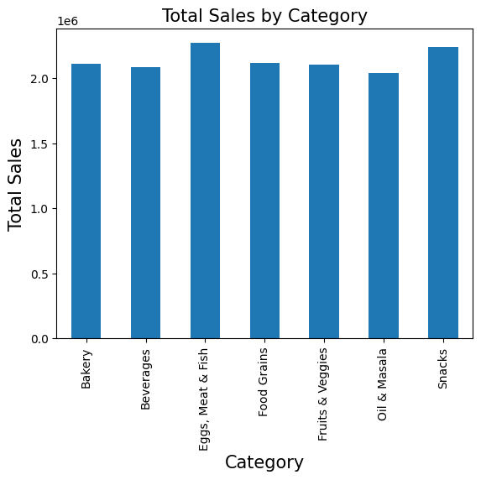
The first chart shoes the total sales by category where we can see that the “Eggs, Meat & Fish” category is the one the highest number of sales.
The company can invest more in this product category.

Slide 4
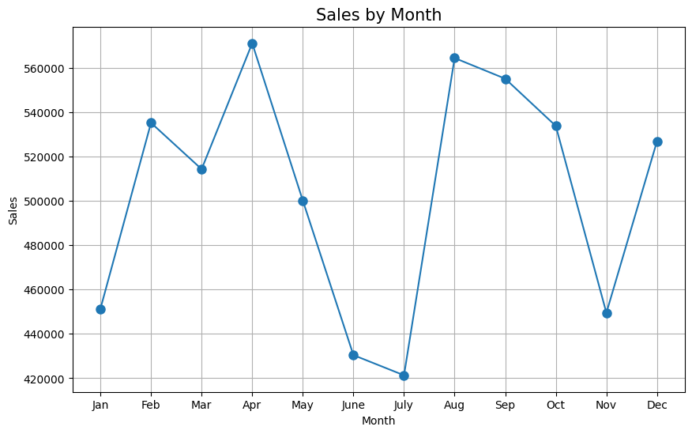
In this chart we can clearly see that the sales is increasing more often when we go towards the end of a year.
Which shows that the company devised a better and suitable plan to increase sales at each point in time.

Slide 5
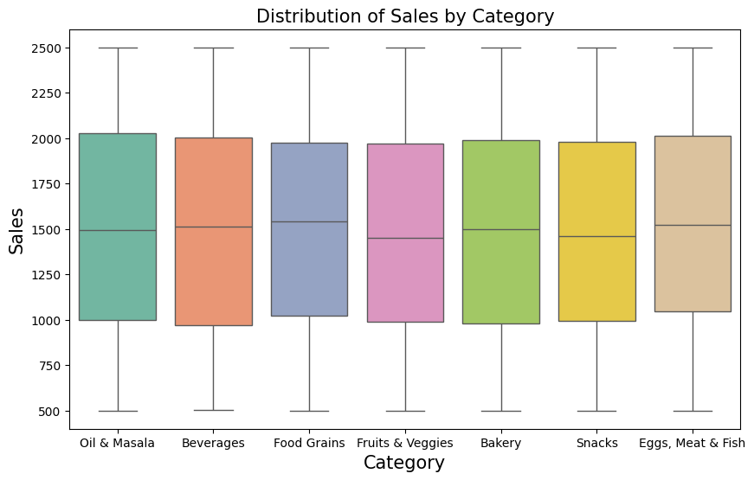
Boxplot to understand the previous line-chart, sales based on category

Slide 6
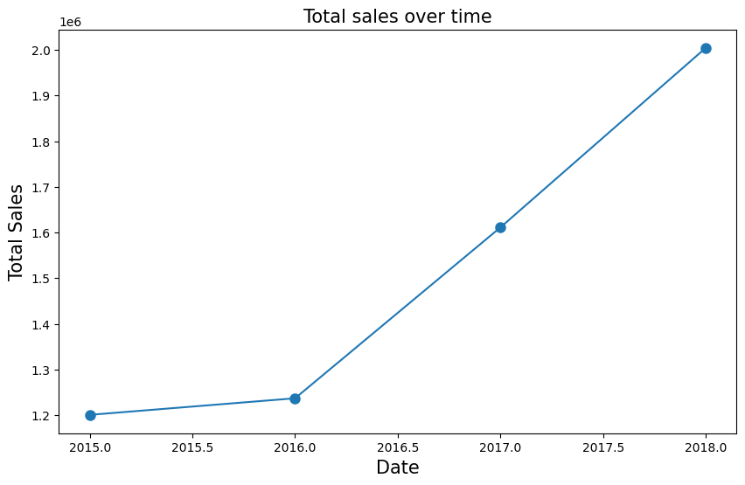
This chart shows properly, how the sales increase over the period of date(years).
As the date increases sale also increases.

Slide 7
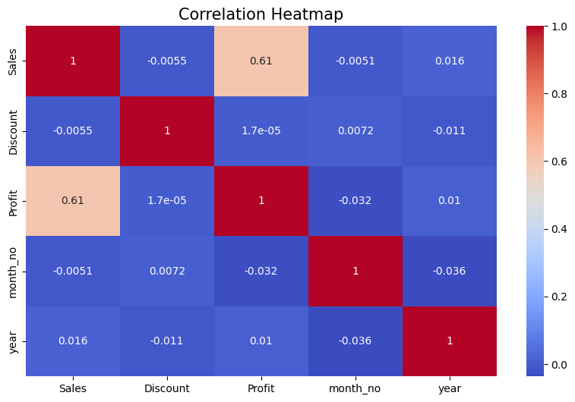
This heatmap shows the correlation between the features such as year, month_no, Profit, Discount, Sales.
The higher the color of relation the better the relation.
Through this company can revise things which can beneficial.

Slide 8
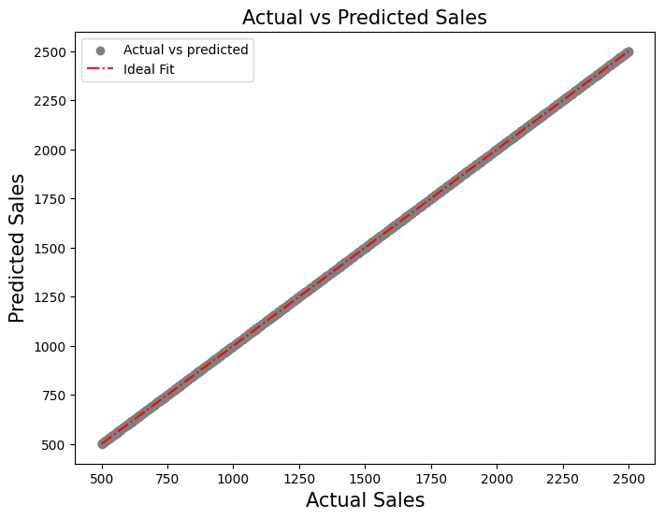
This is the last chart, which describes the relationship between the actual and predicted sales.
As we can see that the actual and predicted are same, which is better, as the company envisions what will be beneficial for them.

Slide 9
Conclusion:
The linear regression model used, can provide reasonable predictions.
The model’s R-squared value indicates a good fit.
This model can be further be refined as per individual ideas.

Slide 10
Thank you

